Slide 1


Deep Learning Activation Functions and Optimizers
This presentation will explore various activation functions used in deep learning, their properties, advantages, and disadvantages. We will also delve into popular optimization algorithms used to train deep neural networks.
by Pankaj Patil

Slide 2
Sigmoid Activation Function
Properties
Use Cases
Range: (0, 1)
Binary Classification
Smooth and Continuous
Probabilistic Outputs
S-shaped Curve
Hidden Layers (Historically)

Slide 3

Vanishing Gradient Problem
1
Sigmoid's Issue
2
Backpropagation Impact
Saturated regions near 0 or 1 result in small gradients.
Small gradients multiply, leading to negligible weight updates in earlier layers.

Slide 4
Zero-Centric Activation Functions
Sigmoid
Tanh
Not zero-centric, output range (0, 1), always positive.
Zero-centric, output range (-1, 1), balanced positive and negative values.

Slide 5
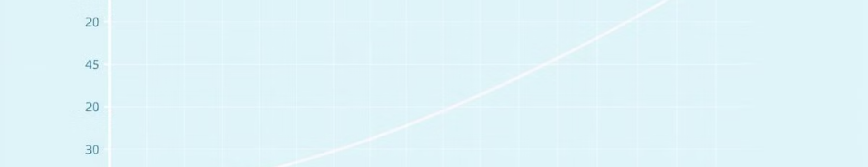
Tanh Activation Function
Properties
Use Cases
Range: (-1, 1)
Hidden Layers
Zero-Centered
Sequence Models
Smooth and Continuous
Feature Scaling
Steep Regions Near 0

Slide 6
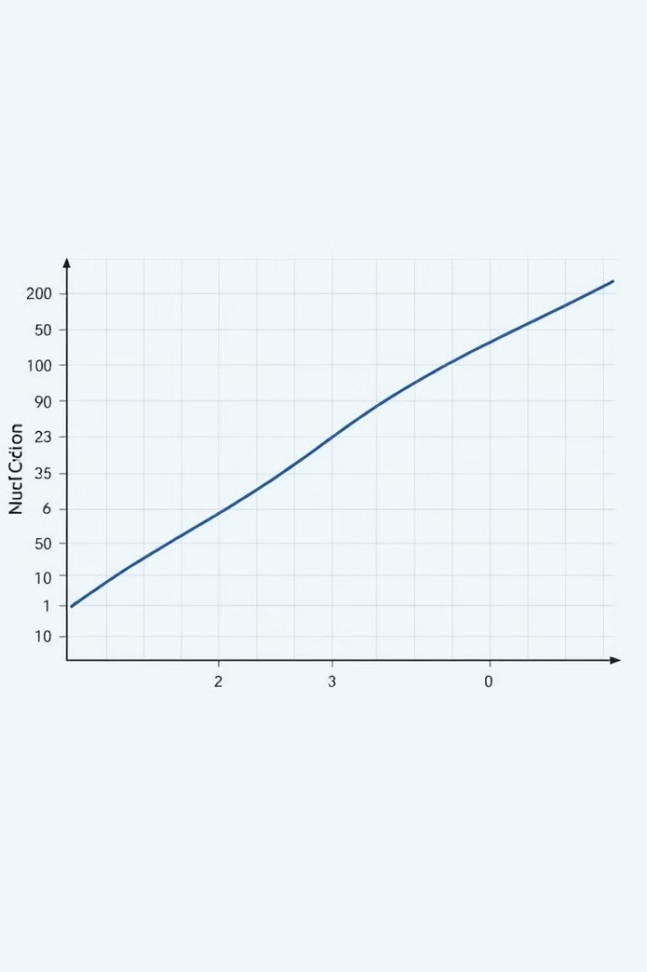


ReLU Activation Function
Advantages
Disadvantages
Avoids Vanishing Gradient Problem
Dying ReLU Problem
Not Zero-Centered
Computationally Efficient
Unbounded Output
Sparsity
Faster Training

Slide 7
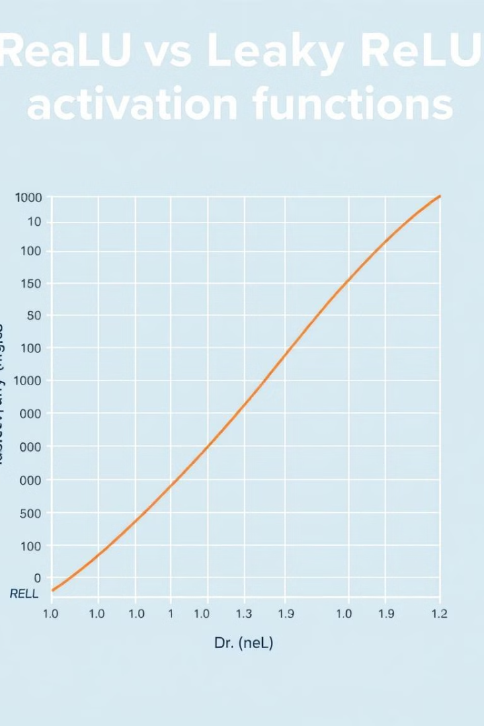
Leaky ReLU Activation Function
1
Leaky ReLU
Addresses the dying ReLU problem by allowing a small gradient for negative inputs.
2
Properties
Range: (-∞, ∞)
Small Slope for Negative Values
Non-Linearity
Computational Efficiency
3
Use Cases
Hidden Layers
Convolutional Neural Networks
Reinforcement Learning

Slide 8




PReLU Activation Function
1
Learnable Slope
Range
2
(-∞, ∞)
3
Non-Linearity
4
Flexibility

Slide 9
Softmax Activation Function
Range
1
(0, 1), sum of probabilities equals 1.
Interpretability
2
Outputs can be interpreted as probabilities.
Differentiability
3
Suitable for backpropagation.
Amplification of Differences
4
Emphasizes differences between logits.

Slide 10

Optimization Algorithms
1
2
Adadelta
Adagrad
Adaptive learning rate, no manual tuning.
Per-dimension adaptation, handles sparse data.
3
4
Adam
Batch Gradient Descent
Combines Momentum and RMSProp, efficient and adaptable.
Full batch update, slow but accurate.

